Slide 1
IoT Gateway

Slide 2
Android Thing vs Uart

Slide 3
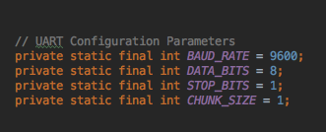
UART Configuration

Slide 4
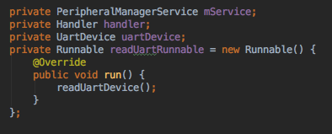
Declarer

Slide 5
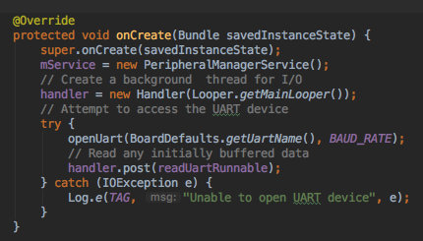
Constructor

Slide 6
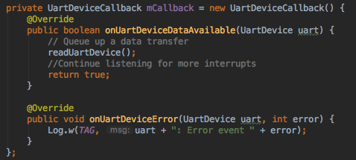
UartDeviceCallback

Slide 7
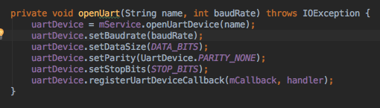
Connect Uart

Slide 8
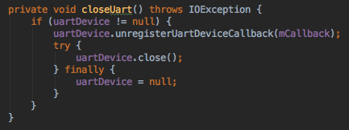
Close Uart

Slide 9
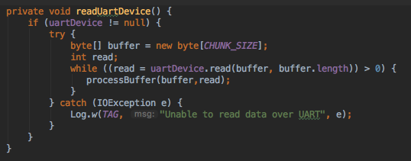
Read Uart

Slide 10
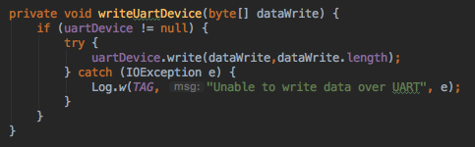
Write Uart

Slide 11
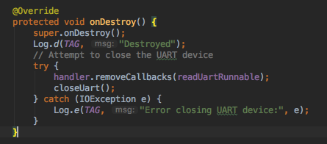
onDestroy

Slide 12
MQTT

Slide 13
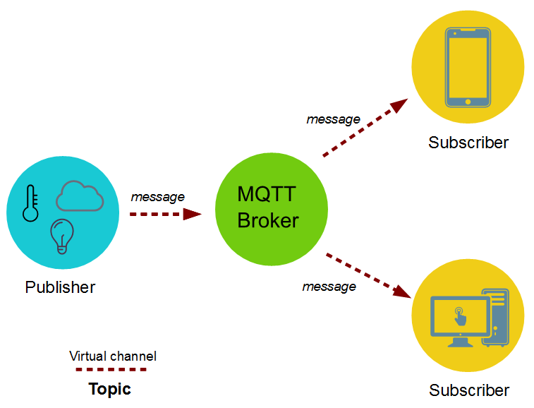
MQTT

Slide 14
Android Thing vs MQTT

Slide 15
Amazon IoT Cloud

Slide 16
End

